Slide 1
edTPA 101
TEI
June, 2017
UNC Charlotte

Slide 2
I. Introductions

Slide 3
II. Overview of edTPA
Notes:
Context why we want them to do this, research based practice, leads to National Boards Certification, our own research on CE training with edTPA shows that this helps

Slide 4
Goals for this session
Familiarizing you with:
edTPA
Content-specific expectations
Candidate outcomes to date
Support strategies
Connections with NC Evaluation system

Slide 5
edTPA Tasks
Task 1 Planning | Task 2 Instruction | Task 3 Assessment
Instructional and social context Lesson plans and Instructional materials, student assessments Planning Commentary | Video Clips Instruction Commentary | Analysis of whole class assessment Analysis of learning and feedback to THREE students Assessment Commentary
Analysis of Teaching Effectiveness Academic Language Development

Slide 6
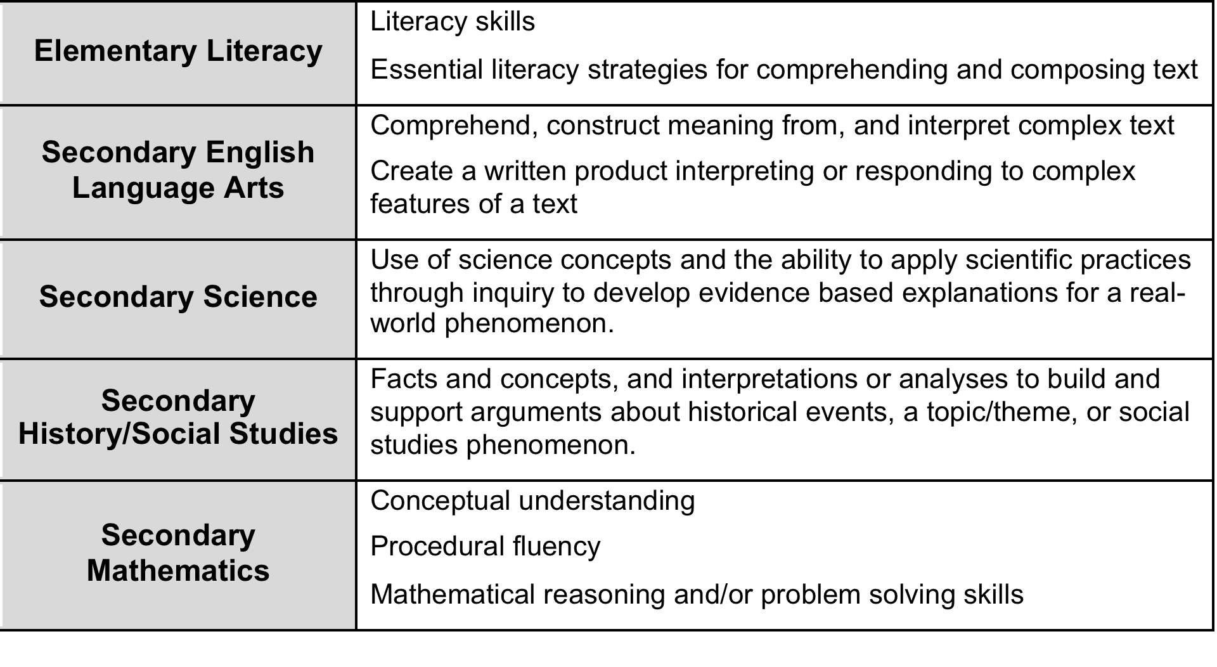
Key Content Understandings

Slide 7
How edTPA is scored
13-15 rubrics, depending on the content area
5 point rubric
Externally scored by calibrated, trainer scorer

Slide 8
Rubric Blueprint
15 rubrics x 3 (score) = 45
Minimum “proficient” at UNC Charlotte = 37 (mostly 3s, a few 2s acceptable)
Task name: Rubric Title Guiding Question
Level 1 | Level 2 | Level 3 | Level 4 | Level 5
Struggling candidate, not ready to teach | Needs more practice | Acceptable level to begin teaching | Solid foundation of knowledge and skills | Highly accomplished beginner

Slide 9
Next phase … learning about edTPA and your content area

Slide 10
Breakout Groups
Content Area | Facilitator(s)
Social Studies | Paul Fitchett and Tom Fisher
Elementary Education 1 (A-E) | Christy Luce
Elementary Education 2 (G-R) | Erik Byker
Elementary Education 3 (S-Z) | Misty Hathcock
English Language Arts | Adam Myers
Math | Michelle Stephan and Mitch Lebowitz
Special Education | Mary Jo Anderson
Directions:
Get in your groups.
Discuss guiding questions + data
Come back to big group in 20 minutes

Slide 11
Guiding questions
Facilitators: please use the questions / data below to begin your group conversations:
Facilitators: share with your group the “highlights” of your handbook data related to edTPA performance. What rubric is the strongest / what rubric needs improvement?
Facilitators: what is the primary content area focus for your handbook?
Teachers: how can you work to support candidates in your content area?

Slide 12
edTPA + Student Teaching
Notes:
Mitch: this is just a quick review of ways we can possibly help candidates in student teaching … just a quick overview / reminder that CE support goes a long way toward helping candidates be successful!

Slide 13
CE Role in supporting edTPA
Guidance on lesson design: which lessons show candidate interactions with students? Which ones showcase candidate’s skills?
Modeling knowledge and skills
Support on logistics: video, securing permissions
We do not tell them what to write; we push them back to the skills/rubrics
Notes:
These are just a few ways that CEs can support candidates overall on edTPA … in your groups, I’m sure you talked about others, and even as we move through this training we can see that there are ways we can begin to support them through the coaching and modeling.

Slide 14
Connecting the dots …
High performance on edTPA
Evidence of good beginning teaching
High evaluation scores on NC Evaluation
Evidence of good experienced teaching
Notes:
Transition …. Final thoughts: there are connections between edTPA knowledge and skills and what is required on the NC Teacher Evaluation that many CEs are already familiar with. The framework for this is demonstrated here … note the progression as students move from candidates to classroom teachers. There is a lot of overlap (next slide).

Slide 15
NC Evaluation alignment with edTPA – a snapshot
NC Eval | Descriptor | edTPA alignment
Standard 1 | “Evaluates student progress using a variety of assessment data” | Task 3 – all rubrics
Standard 1 | “Establishes a safe, orderly environment that empowers students” | Task 2 – Rubric 6
Standard 2 | “Provides an environment that is inviting, respectful, inclusive, supportive, and flexible” | Task 2 – Rubric 6, 7
Standard 2 | “Understand how a student’s culture / background may influence school performance” | Task 1 & 2 – Rubric 3, 7
Standard 3 | “Develop and apply strategies to make the curriculum rigorous and relevant for all students” | Task 1 & 2 – Rubric 1, 2, 3, 7, 8, 9
Notes:
This does not capture the entire alignment between edTPA and NC Eval Tool but rather serves as a snapshot … note there are in most cases multiple places in the NC Eval standards where teachers are asked to do “edTPA-like” things. This is great news for us, because most of our candidates work in NC after they graduate; helps us send the message that we are preparing them for how they will be evaluated in their careers.

Slide 16
NC Eval | Descriptor | edTPA alignment
Standard 4 | “Understand influences that affect individual student learning and differentiate accordingly” | Task 1, 2 & 3 - Rubric 1, 2, 3, 7, 9, 10, 11
Standard 4 | “Uses a variety of data for short- and long- range planning” | Task 3 – Rubric 11, 12, 15
Standard 5 | “Thinks systematically and critically about student learning in the classrooms and what can be done to improve student achievement” | Task 2 & 3 – Rubric 10, 15
Standard 5 | “Adapts practice based on research and data to meet the needs of students” | Task 1, 2, & 3 – Rubric 3, 10, 15

Slide 17
Stay tuned … in our next session, we will work with some edTPA rubrics!

